Slide 1
Module 1 Data@ANZ
By: Christopher Aquino

Slide 2
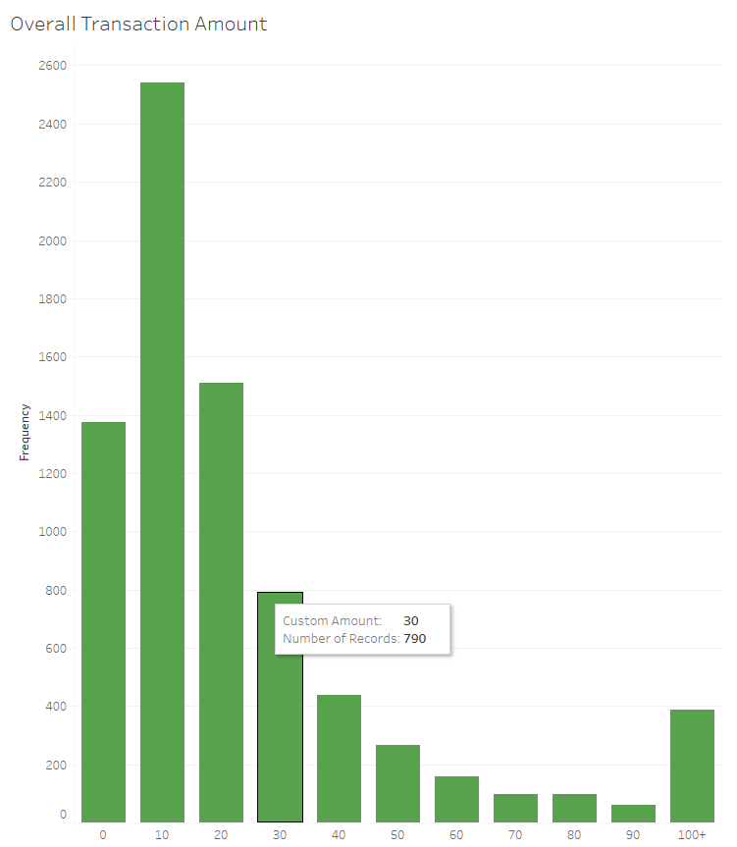
Filtering out everything except POS and SALES-POS, we see that most transactions are between 0-30. However, the average is skewed since there are quite a few large transactions (over 100)

Slide 3
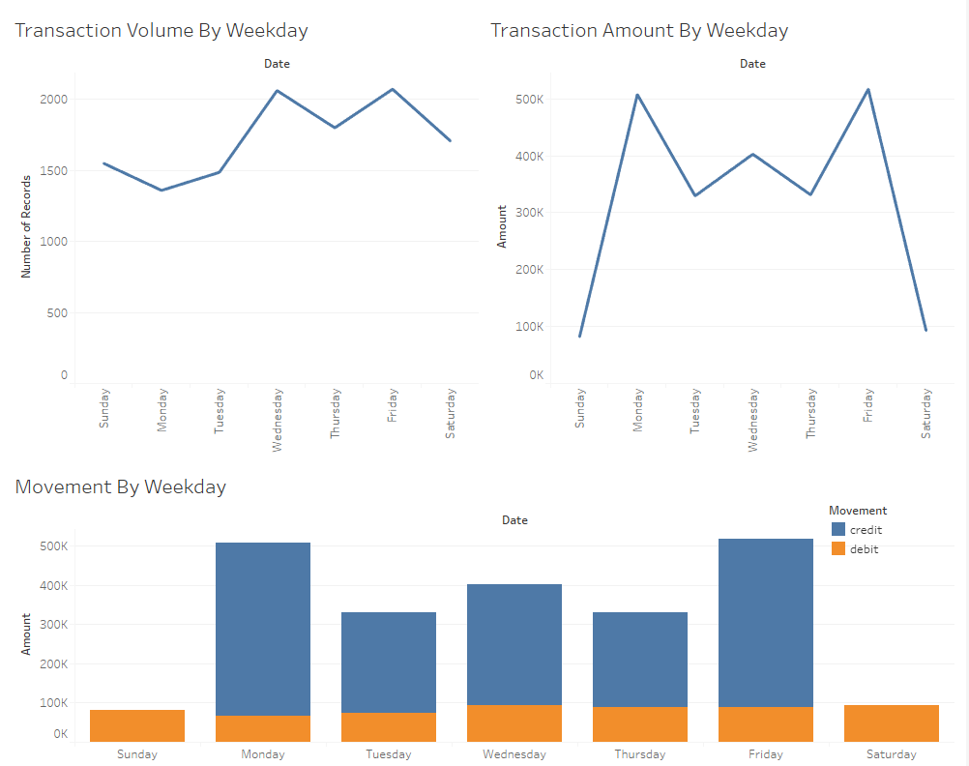
Looking at Transaction Volume and Amount, we see drop in the weekend. However, looking at Movement, we see that credit is not processed during the weekend.

Slide 4
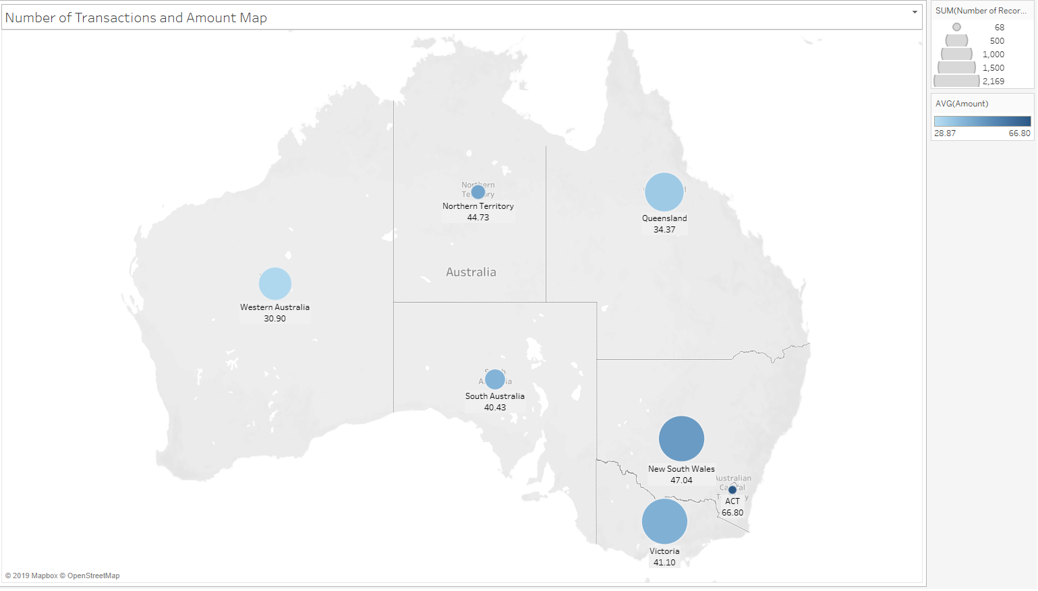
We see high transaction volume in NSW, VIC, and QLD; but the highest Average Transaction Amount is found is ACT

Slide 5
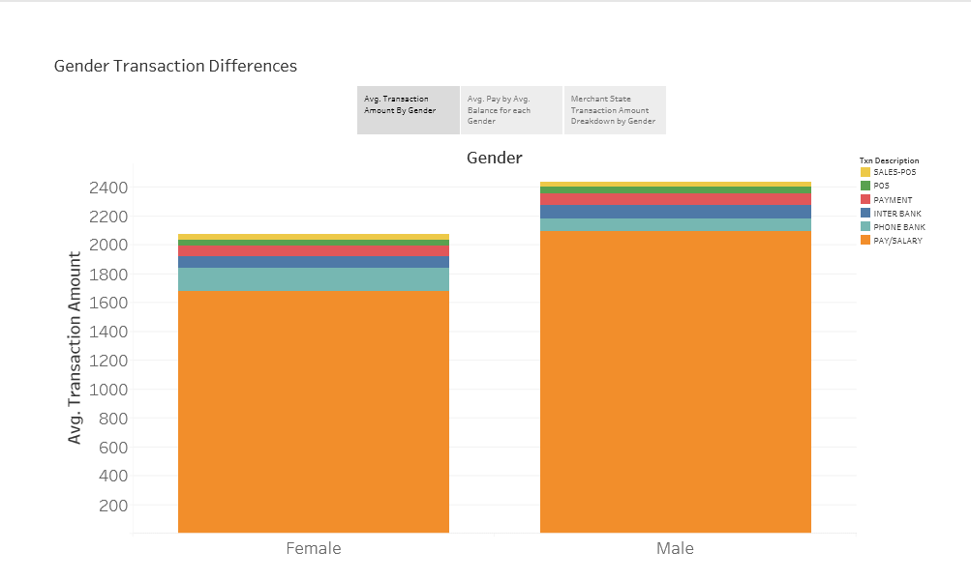
Analyzing the different types of transactions of males and females, we can see that while females are paid less on average, they pay more on average for “Phone Bank”

Slide 6
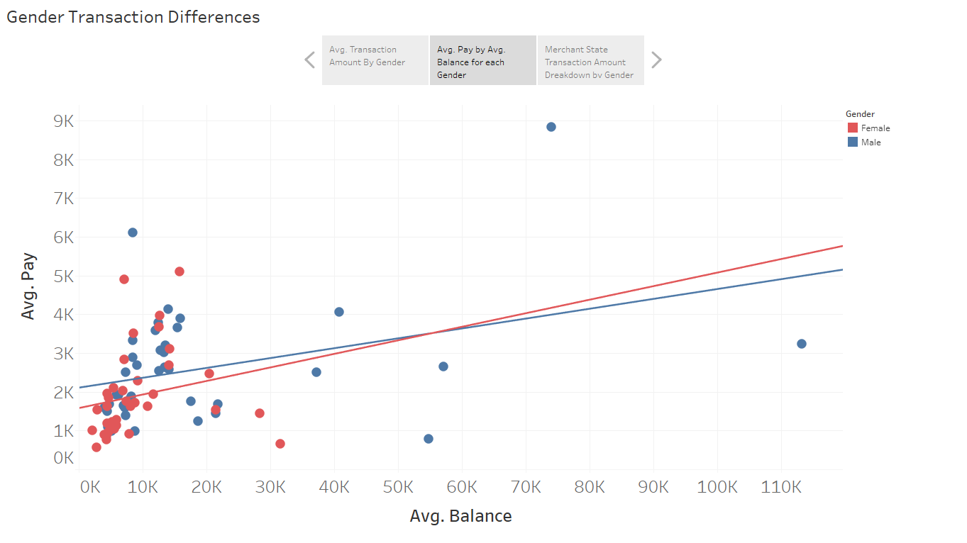
Excluding a few outliers, we find there is no significant evidence for a correlation between Avg. Pay and Avg. Balance for females (P-value=0.2049), but there is for males with 95% confidence (P-value=0.01919)

Slide 7
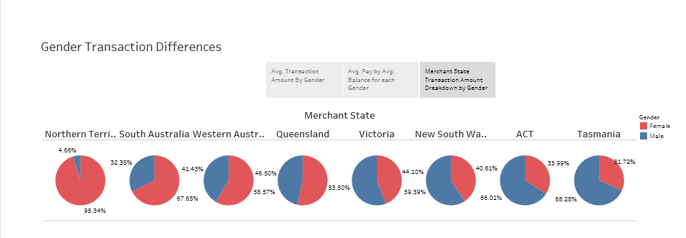
Although males have a higher sum amount, females account for a large percentage at certain Merchant States including Northern Territory, South Australia, and Western Australia

